Slide 1
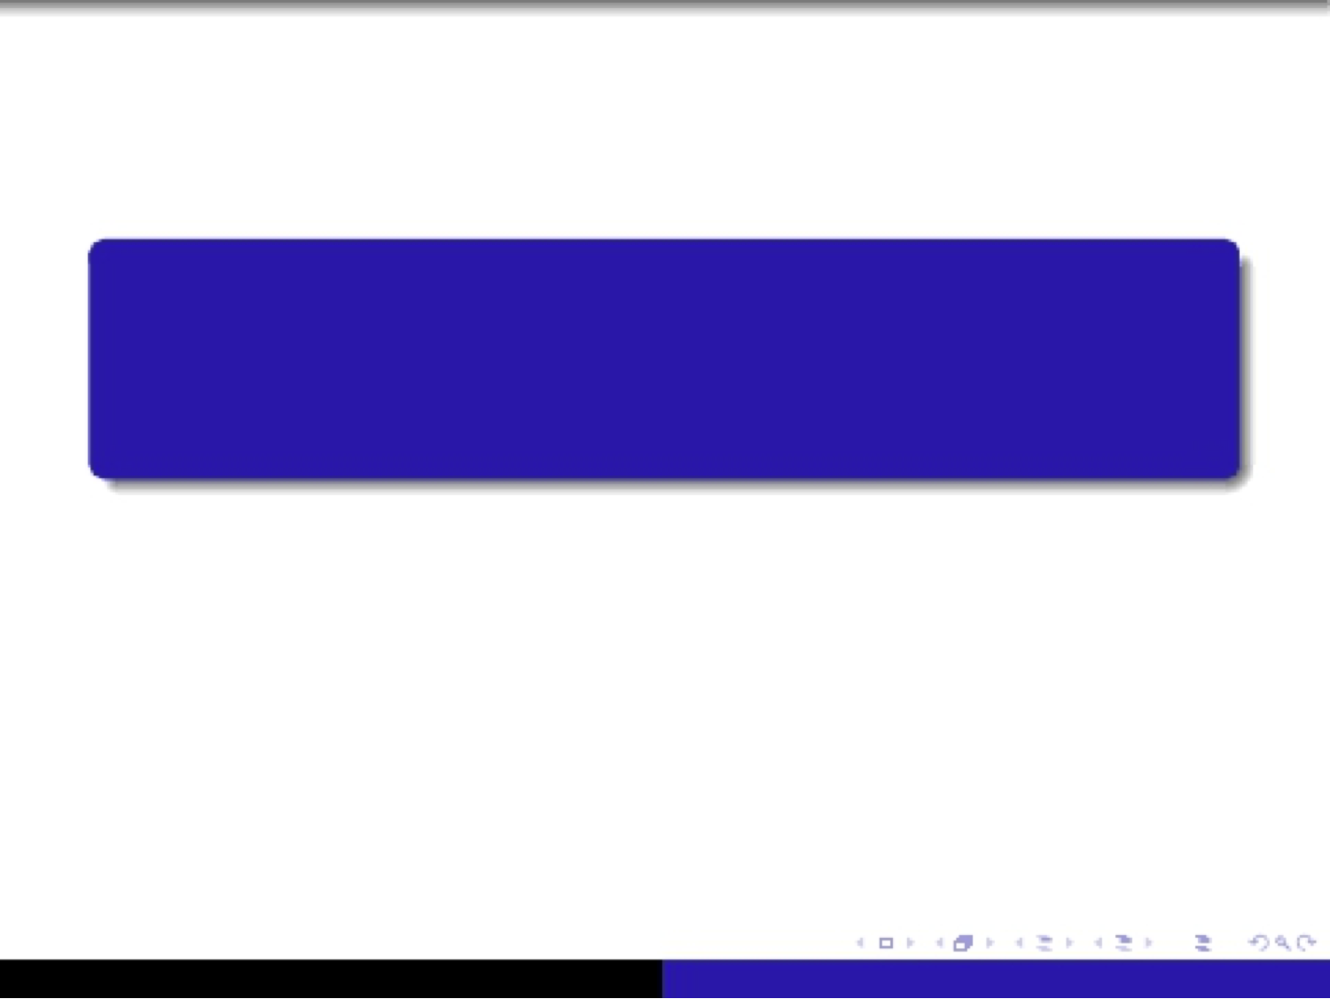
COMP 249- Winter 2014
Tutorial 5 - File I/O and Serialization
Winter 2014

Slide 2
Question 1
Find the Correct Answer:
1. A stream is an object that allows flow of data between :
a) Two computers.
b) A program and a computer.
c) A program and some I/O device or file.
  2. If the data flows out of a program, then the stream is called:
  a) Output Stream.
b) Input / Output Stream
c) Input Stream.

Slide 3
Question 2
How would you append data to the end of a text file?
Show the constructor for the class you would use.
Hint: You may go on the API and find that constructor

Slide 4
Question 3
Take a look at the file named “CounterDemo.java” available on
Moodle. Write the classes CountReader and CountWriter so that the
driver:
  counts how many times particular character, such as ‘a’ …, appears in an input text file, and
  re-writes the content of the text file “input.txt” in the new text file “output.txt”.
You can use the file “input.txt” available on Moodle to test your
program.

Slide 5
Question 4
Mary is a shopaholic! she needs a software that helps her keep track of her
shopping expenses. Every time, Mary buys a new outfit, she would like to add
it to a list of expenses and check if she has exceeded her allowance of 800$ per
month.
Modify the class “outfit” (available on Moodle) to implement the Serialization Interface.
Use the “Serializable Interface” to store all outfits in a file called “Outfits.ser”.
Complete the driver in “shopaholic.java” (available on Moodle) to write a method that returns the amount of money that Mary spent for a particular month.
The next page shows an example of how your program should behave.

Slide 6
Question 4 – Sample Interaction
*****Welcome to the Shopaholic Software****
Main Menu:
1- Enter a new Purchase.
2-Track Spending per Month
0-Exit
1
Please enter month of purchase
3
Please enter Type of outfit purchased
Jacket
Please enter Price of outfit purchased
300
Main Menu:
1- Enter a new Purchase.
2-Track Spending per Month
0-Exit
2
Please enter month of purchase
3
The amount of money spent this month is 300

